Slide 1
Guide to Facilitation

Slide 2
Facilitation Basics
HELP
HELP a group of people understand their common objectives
ASSIST
ASSIST them in plans to meet the objectives
NEUTRAL
Remain NEUTRAL – do not take a particular position

Slide 3
Planning
Become a Master of Resources
Review VE curriculum tasks and resources that are available.
Use the task provided knowing it might change with student input and reflection.
Use the Quick Guide to present and/or review the lesson.
Use the Future of Work Learning Series for step-by-step directions on various topics and activities.
Meet weekly with your Management team
Calendar, Activities Map, Management Team Notes, Company Notes, Department Tasks List

Slide 4
Sample Class Period
Planning
8:00 Arrival: Sign In, To-Do List
Establish daily agenda
8:10 Status/Check-in Meeting w/ CEO, VP or Team Leaders Daily
8:15 Break out meetings &/or work
8:40 Debrief & To-Do – Action Items
8:45 List & Dismissal

Slide 5
Planning
Notes:
Company and Department Meetings: Click to slide with Department meeting schedule. When meeting weekly with your Chiefs, some time should be committed to planning the company and department meetings; Holding these meetings on a regular basis will facilitate you’re the organization of the company.
It gives your Chiefs, VPs and employees to take leadership roles. It helps to ensure everyone is on the same page and moving in the same direction. Great way to ensure communication with the company and departments.
Examples of organization: Facilitator fee - force students to plan before meeting with you. “Consultation fee”/hourly rate for requests outside

Slide 6
Leading
Ask guiding questions
Encourage employees to ask VPs and Management - not you!
Work with Management and VPs to develop leadership skills
Allow students to take ownership
Provide professional development opportunities for the “employees”

Slide 7
Evaluation / Reflection
Goal Evaluation (Company, Department, Personal)
Weekly, Monthly
Business Plan
Employee Evaluations
Monthly, Quarterly
Weekly Log Sheet
Department Challenges
Rubrics
Portfolios
Notes:
11:42-11:50 KENDRA
Everything that has occurred to this point will help you with the Controlling Phase.
REFLECT, REFLECT, REFLECT
This is what I have found to be key for students in VE is reflecting on their learning continuously – demonstrating that it’s okay to fail!
Goal Evaluation – Based upon the weekly goal sheet and the department tasks list, you can work with the Chiefs and VPs to evaluate there progress. On the weekly log sheet, have them answer a few reflection questions on progress of tasks.
At the end of the month, product monthly checks – have them turn in what they have completed – grade using a rubric – have them answer reflection questions.
Employee Evaluations – Typically quarterly – have students prepare goals, reflect monthly on progress, conduct an evaluation meeting with HR, VP, and Chief. Allow HR to run meetings. Meet with HR prior to meeting to discuss evaluation meeting procedures.
Quarterly Test – standards for all students to meet prepare monthly or quarterly test based upon the learning from the month
Example: October – Memo, Business Letter, interviewing skills, personnel files
Rubrics – VE provides rubrics for business letters, business cards, print ads, etc. Use these and have all students prepare this to demonstrate learning – as students prepare as them to reflect on their learning
Examples: Preparing competitions for trade show – have all students prepare a business card and group select which one will compete at Trade Show
Portfolios – Activities/Assignments all students do to demonstrate meeting of the standards – include reflection questions
Examples: Analysis of an Income Statement, Prepare Print Ad,
Purchasing Log – require purchases monthly/quarterly – turn in for review – include reflection questions
End-of-year Reflection: The first year is hard and you wonder if the students learned anything at all. They did. Have them write about it in a memo to you. You will be surprised and amazed at what the students write about. This program makes a difference for students.
ALLOW DO-OVERS! Encourage Do-Overs! Celebrate Do-Overs!

Slide 8
Key to Being a Successful Facilitator
Forgive yourself daily.
Say often, “I don’t know. Let’s figure it out.”
Involve the students in everything!
Planning, Organizing, Leading, Evaluating / Reflecting
Know it will not be perfect. Imperfection is where true student learning will take place.
Facilitate continuous reflection with the students.
Continue to learn and evolve with your students.
Notes:
11:58-11:59
WENDY

Slide 9
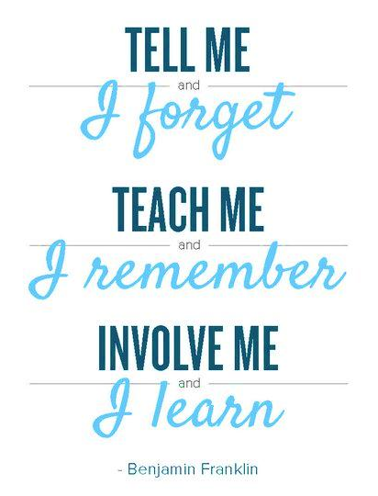
Remember….
Notes:
11:59-12:00
WENDY

